Slide 1


Using Data Science techniques to Automate Report Generation
Quang D. Truong
IDD

Slide 2
Problem:
If you work for IDD, a common problem is having to manage many different client types:
COR
In-country USAID Mission
Ministry of Health or in-country counterparts
Other partners or donors
Each client wants reports. All the reports essentially have the same information, but the data needs to be presented in different ways. This costs a lot of time.

Slide 3
Solutions:
Bad solution: Redo the same report multiple times
Better solution: Manually enter the essential information into a tool, which then generates the report
Best solution: Use data science techniques to automatically generate reports based on existing reports

Slide 4
General Overview
Today, I will show you my process for creating this report generation tool:
Import the document into Python using python-docx library
Run basic NLP data cleaning steps
Create covariates the help us break the document up into the sections we want
Generate report
Use logistic regression to see if Python can break up NEW documents into sections we want

Slide 5
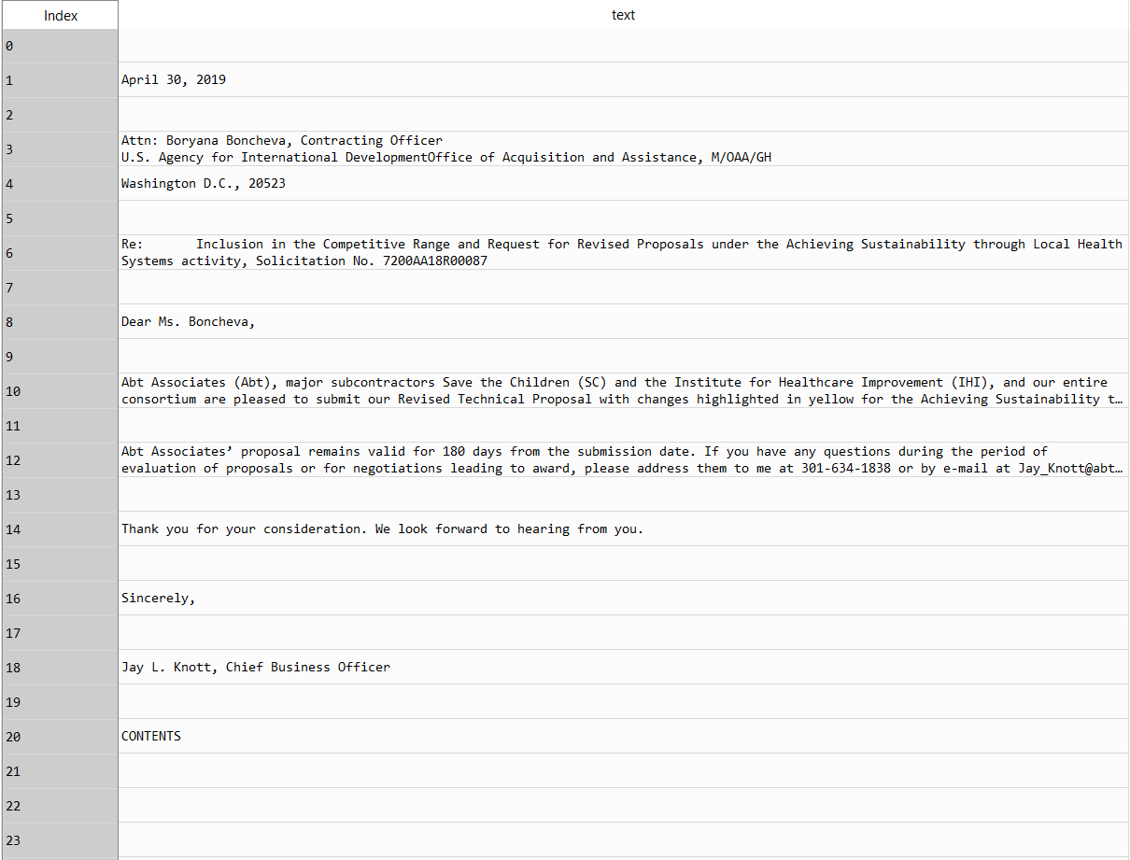
Importing the document
Unfortunately, computers like things to look like spreadsheets, but documents do not.
Python-docx scans the document for lines of text, breaking it down into “paragraphs” and “runs”
End up with a dataframe where each record is a line break (paragraph).

Slide 6
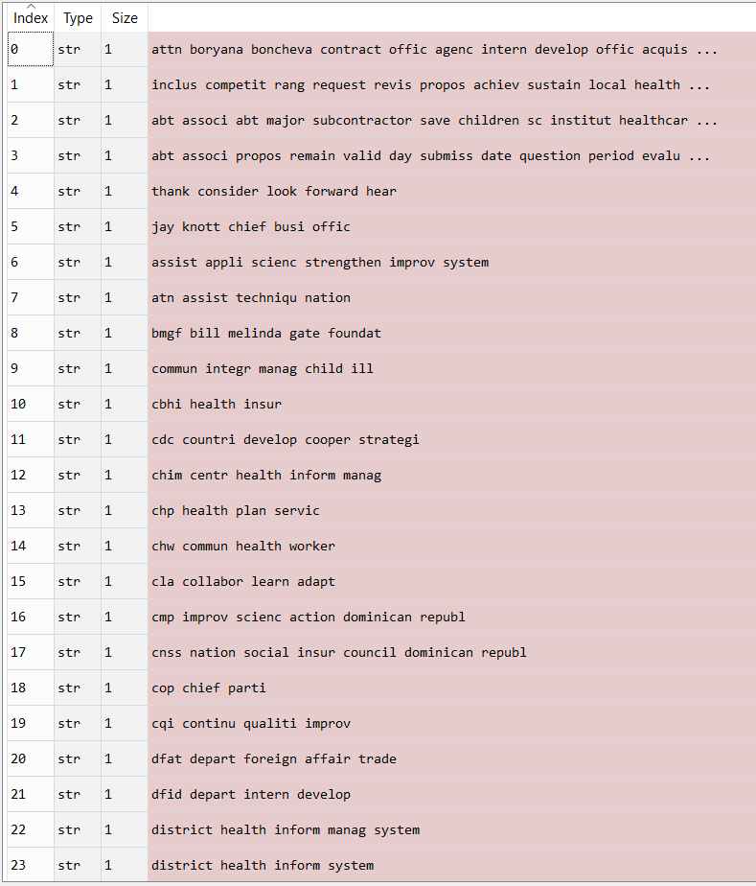
Cleaning the Snippets
Convert all characters to lower case
Remove stop words
Remove punctuation, numbers, and all other symbols that are
not letters of the alphabet
Stem words
End up with a list, with the cleaned/stemmed text

Slide 7
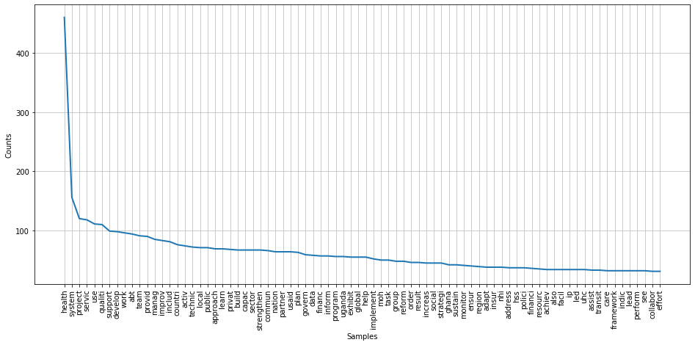
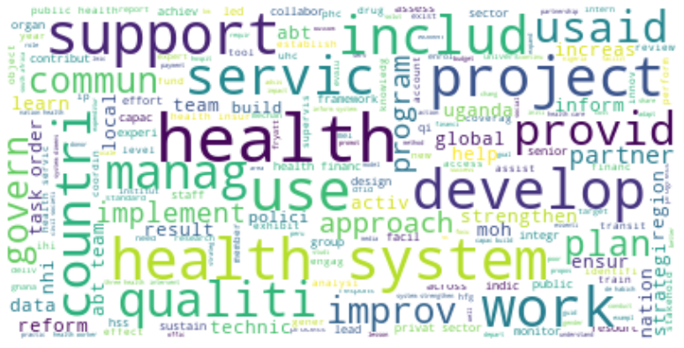
Making a Word Cloud

Slide 8
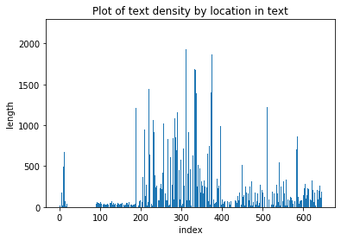
Look for patterns in the data

Slide 9
Look for patterns in the data
Main Body

Slide 10
Look for patterns in the data
TOC/
Acronyms
Main Body

Slide 11
Look for patterns in the data
Preamble
TOC/
Acronyms
Main Body
Appendices

Slide 12
Look for patterns in the data
Preamble
TOC/
Acronyms
Main Body
Appendices

Slide 13
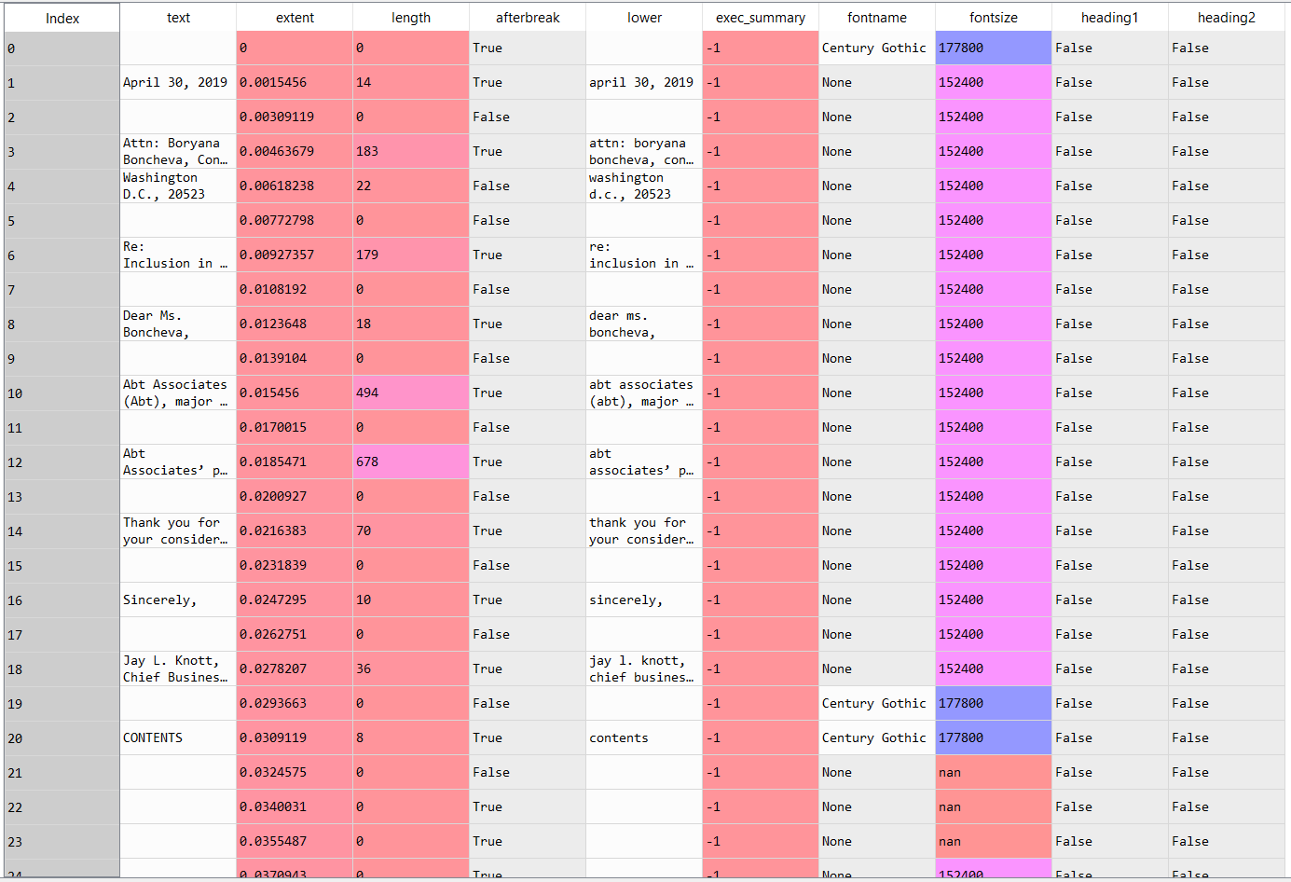
Make other covariates
extent: how far along is the paragraph within the document.
length: how many characters in the paragraph
afterbreak: does the paragraph appear after a blank line?
fontname: name of font
fontsize: size of font
headings: whether the paragraph had a formatted heading.

Slide 14
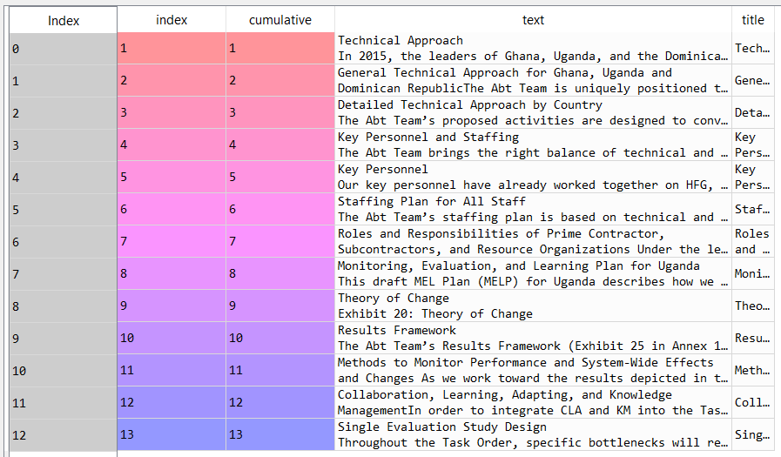
Create output table
Essentially for this document, I defined the section breaks I wanted based on Heading1 and Heading2.
I concatenated all the text BETWEEN each section break and output it into a table with 13 records (i.e. one for each heading)

Slide 15
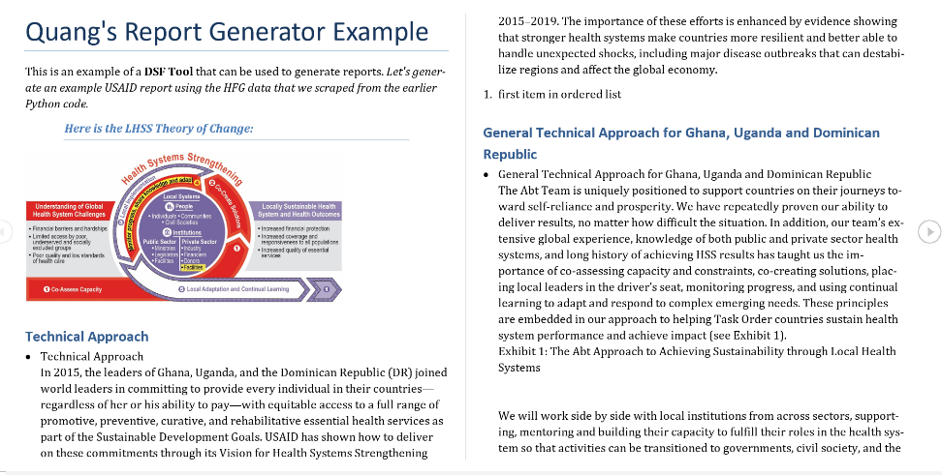
Generate example document
python-docx can output text as well
This report has all the data from the output table.
You can add pictures, charts, etc.
Similar to LaTeX

Slide 16
Applying Predictive Analytics
Why?
Not all documents are formatted in the same way
Predictive analytics (and a big enough data base) will allow us to reliably predict how to break a variety of documents into the sections we want

Slide 17
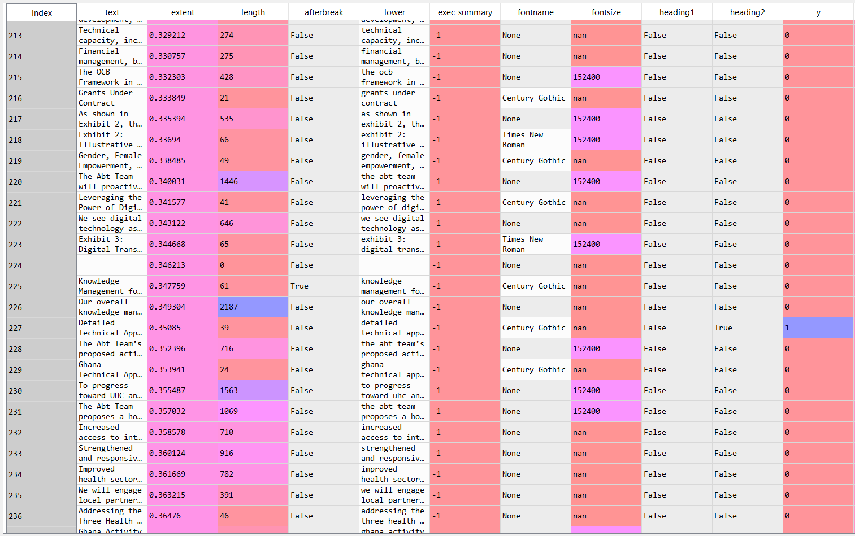
Logistic regression
Manually tell Python which sections we want

Slide 18
Logistic regression:
Run the regression
Choose x variables, choose y variable
Split the data into training and test sets
Fit the model
Use the fitted model to predict on test set
See accuracy
First basic regression, then an “enhanced” regression that applies weighting to get a better prediction.

Slide 19
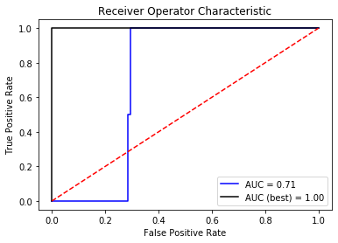
Logistic regression: results
1st model
Accuracy: .9897435897435898
AUC: .71
Confusion matrix:
[[193 0]
[ 2 0]]
Enhanced model
Accuracy: 1.00
AUC: 1.00
Confusion matrix:
[[193 0]
[ 0 2]]

Slide 20
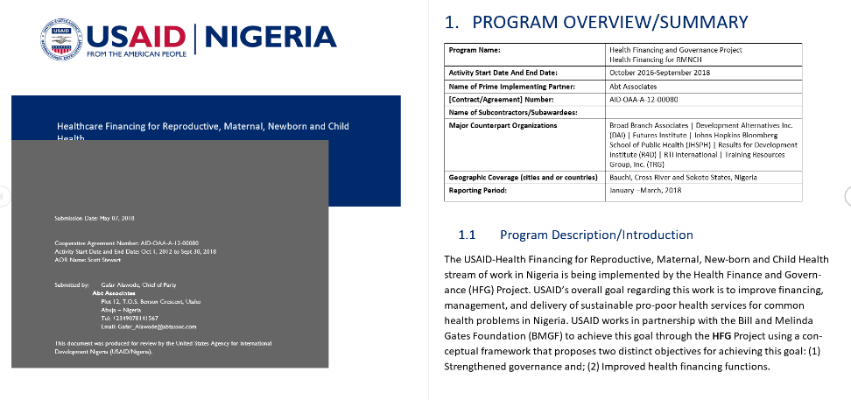
Logistic regression:
Will it work on other documents?
We will look at a completely different document type (HFG Quarterly report)
Use the SAME model, but predict section breaks for this document

Slide 21
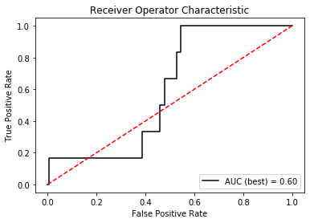
Logistic regression: results
Enhanced model
Accuracy: 0.96491228070175438
AUC: .6
Confusion matrix:
[[164 1]
[ 5 1]]

Slide 22
Next steps:
Improve the predictive model:
I used a very small data set, which led to the model overfitting the first data source (likely weighting the “Headings” covariates too heavily)
Font-size covariate was not working properly
Model itself can be improved (interaction terms)
Decision tree may make more sense for this case
Use more similar document types

Slide 23
Big Takeaways
This is just one application though. Analysis of word documents at Abt has a lot of great applications:
Do a sentiment analysis on a bunch of documents within a single project and find out what went well/what did not.
Searching within a document for skillsets and then using a match algorithm to match that against Abt employees.
Create a crawler to search Abt's H: drive directories to find patterns (i.e. are we balanced in the sectors we put in proposals for? Are there other types of projects that better fit our skills/capabilities?)
Big benefit is that it's not “pre-cleaning heavy”. Also, since it's our reports, don't need approval from clients to use it.

Slide 24
Contact Quang D. Truong Sr. Analyst, IDD Quang_Truong@abtassoc.com https://www.linkedin.com/in/qdtruong/

